Slide 1
AgEing, Dying & Death
Module 4

Slide 2
Learning objectives
By the end of this session you will -
Have discussed the different attitudes to ageing across cultures.
Have explored different beliefs about dying.
Have identified your own cultural attitudes to ageing, dying and death.
Understand religious rules and notions about death from a comparative approach.
Recognise the importance of the "rites of passage“ when dealing with death.
Learn about the major religions' perception of dying and death.
Have become aware that understanding different cultural attitudes to ageing, dying and death will help you in your work.

Slide 3
Introduction
‘I was talking to my colleague yesterday about how we will all get old and eventually die. The conversation began because he was caring for someone he said was quite old. I asked him how old the person was and he said he couldn’t remember the exact age, but quite old. I wondered how old he thought was quite old, it seems to me we all have a different idea about this and we have different attitudes to old people and death. What do you think?’

Slide 4
Perceptions of Age
At what age would you give someone the label of being old?.
Why did you choose that age?
At what age do you think you will consider yourself old?
Why have you chosen that age?
Is it different to your answer to the first question?

Slide 5
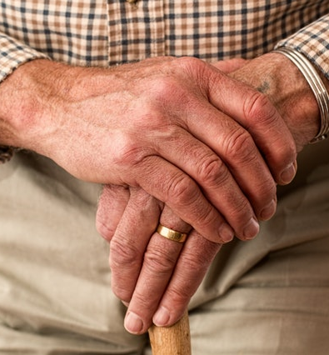
Thinking about age
How do you expect people to think of you when you reach the age that you have just written down?
More important that a young person OR
Less important that a young person
Wise and someone to ask about important things OR
Someone who is out of touch with life and whose opinions and ideas are less important.
Do you think your views are influenced by your own cultural background?
https://www.pexels.com/search/free/

Slide 6
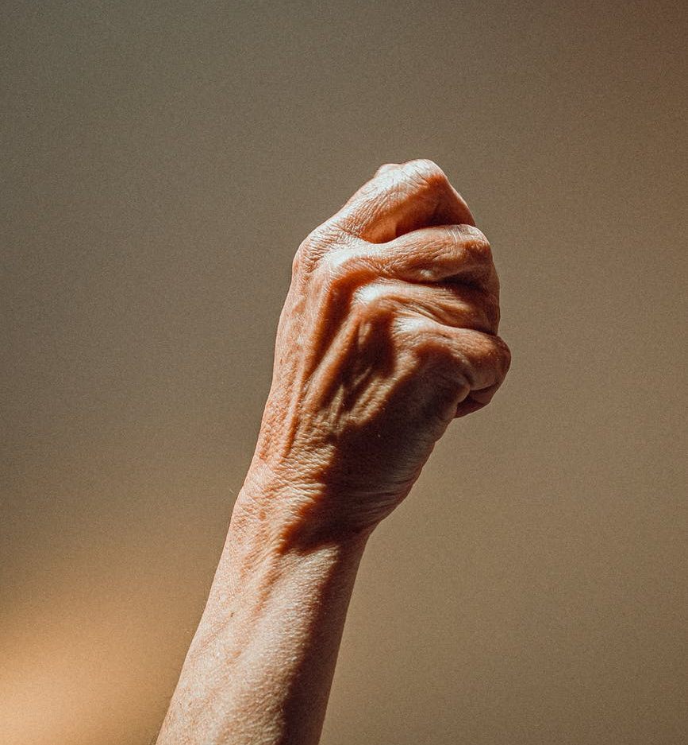
The culture we are born into, grow up in, and live in influences our attitudes to many things including
how we think about aging
how we expect to be treated in old age
our attitudes to the elderly.

Slide 7
Cultural attitudes to ageing
What are the most common attitudes to older people in your culture? Which of these statements do you think are true?
Old people are seen as wise.
It is believed that we should listen to old people.
Old people do not know much about today’s world.
It is difficult having an interesting conversation with most old people.
Old people have different opinions to young people.
It is younger people who are thought of as important and old people should listen to them.

Slide 8
Summary
You might feel that there are right or wrong answers to the questions.
However there are actually no wrong answers. Your answers will depend on 2 things, your own personality and also your own cultural background.
Different cultures view old age in different ways.
For example, in most eastern cultures older people are seen as more important and wiser than younger people.
In these cultures old age is respected and it is disrespectful for older people to be challenged or disagreed with.
In some other cultures older people are not respected in the same way - beliefs and attitudes towards them may be less positive, even if people are outwardly polite and respectful to them.

Slide 9
Approaches to Dying

Slide 10
We are all born and we will all die
We all are born and we will all die. However cultures differ in their beliefs about the dying process and what happens when death occurs.
Some religious and cultural traditions, such as Hinduism, envisage a cyclical pattern of life and death where a person is thought to die and be reborn with a new identity which can occur multiple times.
Christians believe that death only occurs once, that people shed their bodily form which continues in spirit, and believers will then be welcomed into heaven.
Amongst some cultures it is believed that the living and the dead co-exist and the dead can influence the well being of the living.
In some cultures the ancestors are revered and must be looked after to ensure they have all they need in the afterlife.

Slide 11
Different notions on death and the afterlife
The afterlife can be perceived as everything from:
A meaningless and desolate place (such as Hades, the realm of the dead in ancient Greek culture).
A happy place (such as in Islam and Christianity's conception of Paradise).
An immediate transition to a new life but for others it leads into entirely new forms of existence (such as in Hinduism).

Slide 12
A Good Death
No one wants to die but when we do we would all like a good death.
Q. What would you consider a ‘good death’ for either yourself or a member of your family?
Q. Do you think that your views mirror those of your family, peers or work colleagues?
(Discuss why you think they do/do not).

Slide 13
Death Affirming and Death Denying/Defying Cultures
Some cultures appear to manage the idea of dying well. That is death is not feared to a high level. These cultures can be referred to as death affirming cultures.
In other cultures, the aversion to dying is so strong that they could be called death denying or defying cultures.

Slide 14
Death affirming Cultures
Some cultures are more accepting of death as inevitable.
They conceive it as a mere transition from one state to another.
The most effective way to defeat death is to accept it.
https://www.pexels.com/search/free/

Slide 15
Death denying / defying cultures
Where people use words to describe dying like ‘passing away’ so as to avoid the word ‘death’.
They discuss ‘fighting an illness’.
They equate the death of the body with the death of self.

Slide 16
Your cultural attitudes
Discuss the statements and decide which most apply to how you think about death.
I see death as something to be feared.
I accept death as fate that will come to everyone.
I have a belief in an afterlife that makes death less scary.
I see death as a transition from one state to another one.
I don’t have a belief in an afterlife so I believe death is final.
Death is a private event just involving very close family.
I see death as something that involves the wider group of family and friends and community.
When someone dies I am most likely to say that they have ‘passed away’ or ‘passed on’.

Slide 17
Summary
Different cultures have their own notions of how it is best for death to occur, what is acceptable and what is a good death.
These could be:
Non-dramatic, disciplined with little emotion.
When there has been time for the dying person to complete unfinished tasks.
When the person is able to die at home surrounded by family and loved ones.

Slide 18
Rites of passage

Slide 19
Rites
Some rituals mark transitions - someone or something goes from one state or status to another, such as a change in age or social status (e.g. birth, puberty, marriage, widowhood and death)
In 1909, a French ethnographer Arnold Van Gennep introduced the concept of “rite de passage" or ‘rites of passage’.
Buddhist Death ritual (dying.lovetoknow.com)

Slide 20
Rites of passage
Van Gennep found that although transition rituals vary from culture to culture, they all have a common structure which consists of the following three phases:
Separation rites, where the object of the ritual is separated from its usual context.
Liminal rites, where the transition itself takes place.
Incorporation rites, where the object is part of its new context.
Maasai-rite-de-passage atheleticcourage.com

Slide 21
Rites of passage phases (cont.)
The separation phase:
The object of the ritual, i.e. the person the ritual is about (the initiate) is separated from its usual context. This is marked in a special way e.g. the initiate is dressed in special clothes or painted in special colours.
The liminal phase:
The time in the ritual when the change (transformation) takes place. The term "liminal" comes from the Latin word "limen," meaning limit or threshold. It is in this phase that the boundary between the old state and the new must be is crossed. The boundary must be acknowledged symbolically. It marks that the initiate is putting the old behind them and entering a new state. The object is here "reset." The initiate is without status and identity. This state between the old and the new identity is "fluid." The initiate is existentially vulnerable, but also susceptible to the change that the ritual will bring about.

Slide 22
Rite of passage phases (cont.)
The incorporation phase:
The initiate has now gained a new status and a new identity. The incorporation often takes place in festive forms. Any taboos from the second phase are removed. This phase is characterised by the fact that what is said and done is no longer so intense, and therefore not perceived as so solemn. Instead of incorporation, one can also speak of de- sacralization (sanctification). This is often done by gift exchange, or by giving speeches. The initiate is also given a new name or title.
A transition ritual is thus a ritual that marks a change of status. This type of ritual is known in all societies and religions. The analysis model can be applied to all kinds of life transitions and religions. The rites themselves, are different.

Slide 23
Rites of passage
Think about the culture to which you belong and share and discuss the main parts of the rites of passage provided for someone when they die.
First….
Then….
Then…
Afterwards….

Slide 24
Summary
A transition ritual is a ritual that marks a change of status. This type of ritual is known in all societies and religions. The analysis model can be applied to all kinds of life transitions and religions.
Every culture marks the rites of passage between life and death in outwardly different ways, with different styles of ceremonies.
However there are inherent similarities in all rites of passage.

Slide 25
major religious beliefs - perceptions of death and dying

Slide 26
Relationships of world religions to death
The perception of death within the major world religions can be characterised as either cyclical or linear. In the following, beliefs about death in 5 religions are briefly discussed:
Cyclical Perceptions
In Hinduism, death is only a bodily death as the soul proceeds to be reborn later. The ultimate goal of Hinduism is to be freed from the wheel of rebirth, Samsara, in order to be united with the Universe, Brahman. Death is therefore a liberation from this life, and a possible union with Brahman. If one is not united with the Universe, which is the power in and over all, one dwells in the realm of the dead, the realm of Yama, while waiting to be reborn. While in the realm of the dead, one is dependent on the sacrifices of close relatives as it is a vulnerable time.

Slide 27
Cyclical perceptions
In Buddhism, life is considered as suffering. Death is therefore a deliverance from suffering. This liberation is usually only temporary, as they are usually reborn into a new life. The new life will be exactly as good or bad as their actions in this life have been. Until they are born again, they dwell in one of the many heavens or hells that exist. The ultimate goal is to become free from this cycle of rebirth, to attain Nirvana (often described as nothing). It is achieved by realizing that everything is suffering and thereby reaching beyond that, not holding on to life. Since it is holding on to life, which gives bad karma.

Slide 28
Linear perceptions
In Judaism, it is believed that all who have died, at the end of time must be resurrected to be accountable to God. Here it is decided who is to be condemned to eternal damnation and who is to live in the kingdom of God. The basic idea is that soul and body cannot be separated, and that God has the power to create and recreate everything. The deceased is buried as soon as possible after the death. S/he is washed and wrapped in a white cloth, by a special funeral company that is part of the congregation. The body is placed in a wooden coffin and if it is a funeral outside Israel, a little soil from the Holy Land is usually placed under the head. Flower decorations are not usually used. The following week the bereaved say kaddish (an Aramaic prayer praising God). The mourning period is for a year. No the anniversary of the death candles are lit.

Slide 29
Linear perceptions
Christianity. In the Old Church, Christians and Jews shared the same belief in the afterlife, that on Judgment Day everyone should be resurrected with their bodies. Today, many Christians believe that the deceased ascends to heaven after death to live in paradise. Many people believe that it is not necessary to wait for Judgment Day to be saved. Christians are buried so that the dead look to the east. This is connected with the idea that Christ, on his return on the Day of Judgment, comes with the rising sun to call the dead up from the graves. Today both burial and cremation are used, but up to 1850 it was thought that cremation was incompatible with the Christian faith.

Slide 30
Linear perceptions
Islam. Everything, including death, comes from Allah. A Muslim must therefore be ready to face death when s/he is supposed to be. The most important thing is that they have lived their life in a good and responsible way, that they have been a good and obedient Muslim to Allah. When a Muslim dies, the spirit of life (soul) leaves the body. This is followed by a stay in the tomb where the deceased is interrogated by two angels and receives the final verdict.
What happens from the individual death to the Day of Judgment is controversial and diverse, but on Judgment Day everyone, both living and dead, must be judged on their deeds. Burials in Islam usually follow the instructions given by the Prophet Muhammad.
The body is buried as soon as possible, preferably on the same day. After a ritual wash, the body is clothed in a white cloth and carried to the mosque or burial ground. The deceased is placed with their head facing Mecca. During the entire process, from the home to the cemetery, recitations are given from the Koran.

Slide 31
Cyclical or Linear?
Whether you follow a religion or not, discuss
- if you think that the culture you belong to, follows cyclical or linear beliefs and why you think this.

Slide 32
Summary
We all must eventually die. What we believe in and where we go after death will depend on whether we follow a religion or no religion and which religion we follow.
However even if we have no religion it will still be important to us to go through some sort of rite of passage at the end of our life or for others to whom we are close.
The people for whom we provide care will have their own individual needs and also be part of the wider needs of the culture that they belong to.
We need to ensure that these needs can be discussed and met to allow for the smooth transition of the body leaving the earth to go where the individual believes it to go.

Slide 33
working across cultures

Slide 34
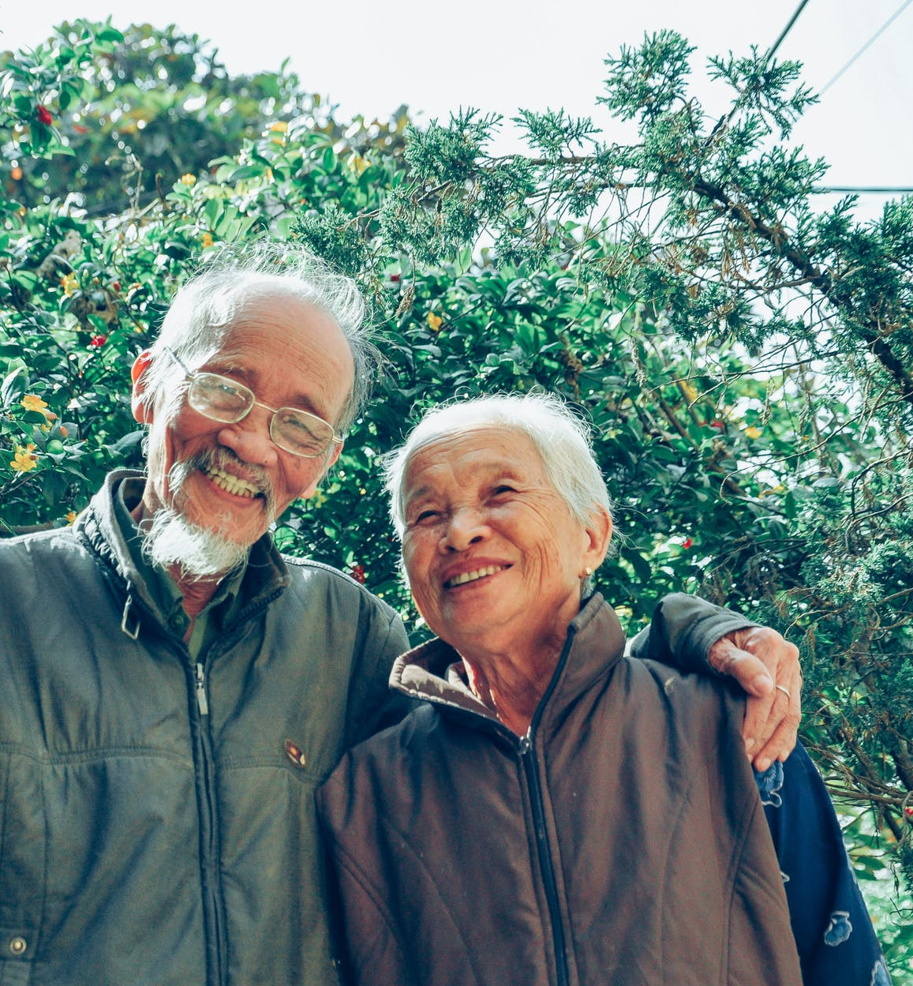
Working with older people
Our attitudes to old people can differ from others with a different cultural background to ourself.
This can effect how we view them, how we listen to them, how we acknowledge what they are saying and what we provide for them.
It can also affect the extent to which we involve their family members in their care throughout their life and during end of life care.
https://www.pexels.com/search/free/

Slide 35
Working with older people
What are the main things to think about to provide a culturally appropriate service to an older person?
Which of the statements do you agree with and why?
You should automatically give older people respect because of their age.
You should always include the family and also ask them what they think is the best for their relative.
You must ask the older person directly what they actually want.
You should provide what you think they want and what is right for them.
You go directly to the family, not to the older person, and ask them their wishes.
You think it doesn’t matter what age someone is, you will treat them in the same way as everyone else.

Slide 36
Summary
When dealing with or providing care to an older person it is important to take their cultural background into consideration. This means you have to take the time to ask questions and listen to the answers that they are giving you.
You must be aware of your own cultural influences and the impact they can have on your views of what is relevant and important.
Different cultures view ageing, death and dying in different ways and deal with both the emotions of ageing, the expectation of dying or being bereaved in different ways.
Living in a society represented by many cultures and religious beliefs means that attitudes to ageing, dying and death can be different from your own.

Slide 37
Action Plan
ACTION PLAN Answer the questions:
What have I learnt about myself and my own cultural background?
What have I learnt about ageing, dying and death?
What else would I like to know?
What changes will I make in my current practise to ensure that all cultural considerations are in place for the people for whom I care?

